Slide 1


BOOTSTRAP
Lecture-11

Slide 2
Today’s Agenda
BootStrap Cards
Card , Card Body, Card Text
Using Images
Using List Groups With Card
Using Background Colors
Different Types Of Cards

Slide 3
BootStrap Cards
A card is a content container that is flexible and easy to extend.
Coming with a variety and components and options for styling and aligning, Bootstrap 4 cards offer extensive use-cases

Slide 4
Card Body
The main class that offers the card functionalities is the .card class.
All other components go inside the .card element.

Slide 5
Card Body
The main building block of a Card is the card body.
The body offers a padded content region that takes up the entire width of its Card.
To add a body to the card, we need the .card-body class.

Slide 6
Example
<div class="container">
<div class="card">
<div class="card-body">
Hello world!
</div>
</div>
</div>

Slide 7
Output

Slide 8
Card Title
To add a title to our card, we can add the .card-title class to an <h[size]> element.
And to add a subtitle, we can use the .card-subtitle card on the <h[size]> elements.

Slide 9
Card Title
To align the items with the rest of the content, it is preferable to add titles and subtitles inside the .card-body.
For adding a block of text inside the .card-body without any extra styling, we can use the .card-text class.

Slide 10
Example
<div class="card">
<div class="card-body">
<h4 class="card-title">Bhopal</h1>
<h6 class="card-subtitle mb-2 text-muted">Capital city of Madhya Pradesh</h2>
<p class="card-text">Bhopal is the capital city of the Indian state of Madhya Pradesh ...
</p>
</div>
</div>

Slide 11
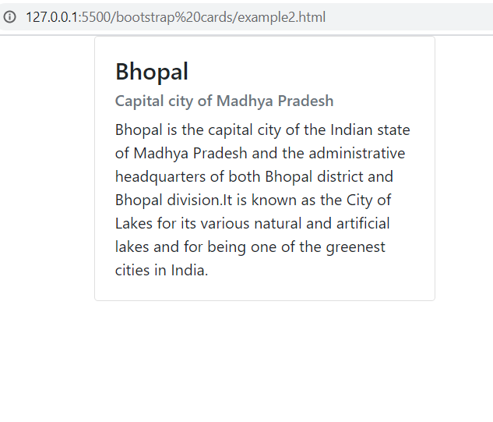
Output

Slide 12
Card Links
To add links to our Card, we can use the .card-link class on the <a> tag.
This ensures that our links are nicely aligned if we have more than one positioned on a single line.

Slide 13
Example
<div class="card">
<div class="card-body">
<h4 class="card-title">Bhopal</h1>
<h6 class="card-subtitle mb-2 text-muted">Capital city of Madhya Pradesh</h2>
<p class="card-text">Bhopal is the capital city of the Indian state of Madhya Pradesh ...
</p>
<a href="#" class="card-link">Read More</a>
<a href="#" class="card-link">Book a Trip</a>
</div>
</div>

Slide 14
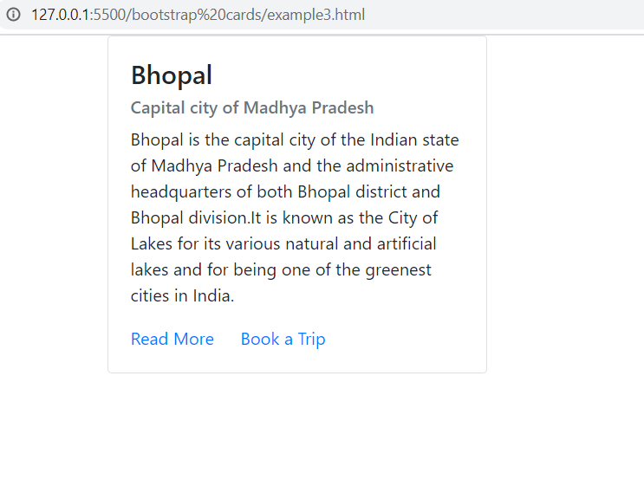
Output

Slide 15
Card Images
Cards have multiple options for adding images.
We can choose to add an image as a cap to the top
We can choose to add an image as a footer to the bottom
We can have it as a background, with the content being displayed over it.

Slide 16
Image On Top
To add an image to the top of a card, we need to place the image as the first element before the .card-body.
In order to have it aligned with the rest of the card, it needs the .card-img-top class

Slide 17
Example
<div class="card">
<img class="card-img-top" src="../images/bhopal2.jpg" alt="Bhopal">
<div class="card-body">
<h4 class="card-title">Bhopal</h1>
<h6 class="card-subtitle mb-2 text-muted">Capital city of Madhya Pradesh</h2>
<p class="card-text">Bhopal is the capital city of the Indian state of Madhya Pradesh ...
</p>
<a href="#" class="card-link">Read More</a>
<a href="#" class="card-link">Book a Trip</a>
</div>
</div>

Slide 18
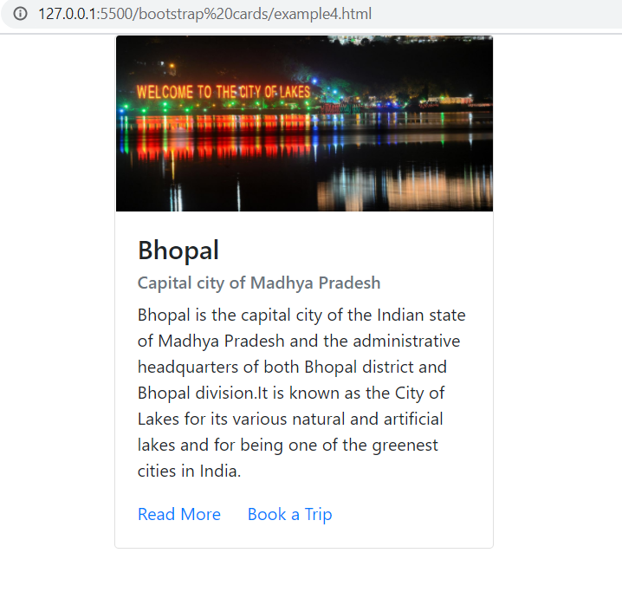
Output

Slide 19
Image At Bottom
If we want to add an image cap at the bottom of the card, we can use the .card-img-bottom class on an <img> tag placed after the .card-body.

Slide 20
Example
<div class="card">
<div class="card-body">
<h4 class="card-title">Bhopal</h1>
<h6 class="card-subtitle mb-2 text-muted">Capital city of Madhya Pradesh</h2>
<p class="card-text">Bhopal is the capital city of the Indian state of Madhya Pradesh ...
</p>
<a href="#" class="card-link">Read More</a>
<a href="#" class="card-link">Book a Trip</a>
</div>
<img class="card-img-bottom” src="../images/bhopal2.jpg" alt="Bhopal">
</div>

Slide 21
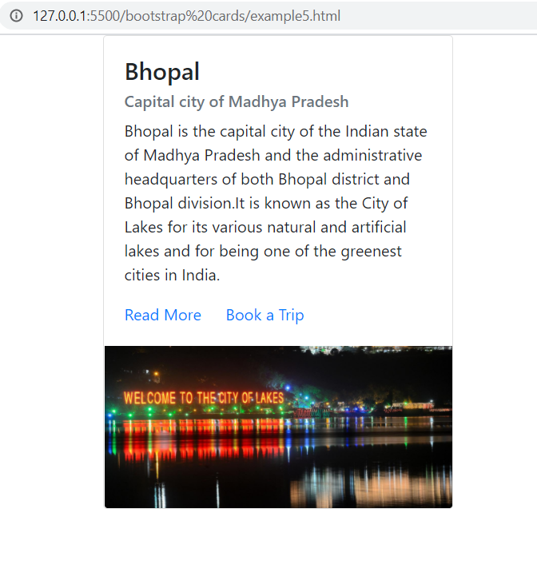
Output

Slide 22
Image Overlays
To have an image as the background of the Card we need to add the .card-img class.
And in order to place content over it, we will need to use the .card-img-overlay class.
We will need to place all our components inside the overlay.

Slide 23
Example
<div class="card">
<img class="card-img" src="../images/bhopal.jpg" alt="Bhopal">
<div class="card-img-overlay text-white d-flex flex-column justify-content-center">
<h4 class="card-title">Bhopal</h1>
<h6 class="card-subtitle mb-2 text-muted">Capital city of Madhya Pradesh</h2>
<p class="card-text">Bhopal is the capital city of the Indian state of Madhya Pradesh ...
</p>
<a href="#" class="card-link">Read More</a>
<a href="#" class="card-link">Book a Trip</a>
</div>
</div>

Slide 24
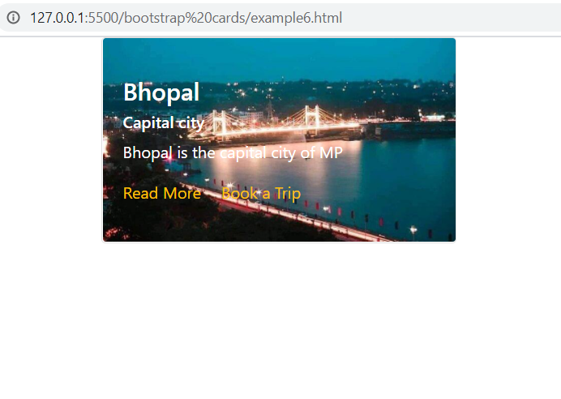
Output

